Slide 1
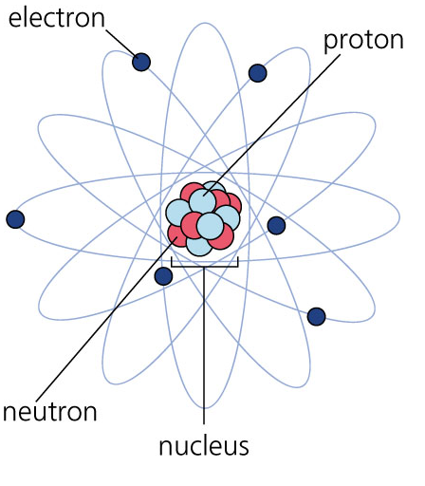
Atomic Structure
Protons are located in the _______ of an atom
Protons have a __________
charge

Slide 2
Atomic Structure
Neutrons are located in the nucleus of an atom
Neutrons do not have a
charge( ___________)

Slide 3
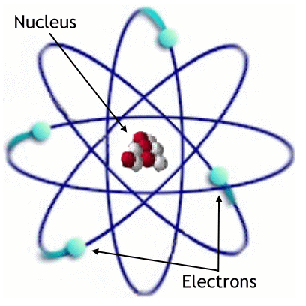
Atomic Structure
Electrons are located _________ of the nucleus
Electrons have a
__________ charge

Slide 4
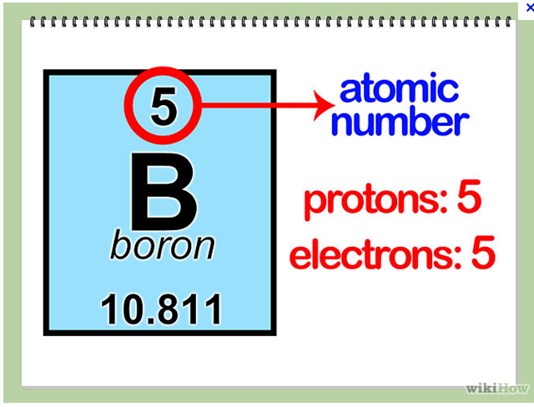
Protons
The # of protons is same as:
  The ___________ Number

Slide 5
Electrons
The # of electrons is same as:
  The ____________ Number

Slide 6
Neutrons
The # of neutrons is determined by:
  Rounded atomic _____ - Atomic ________
  Eg. Boron
    ____ – 5 = _____

Slide 7
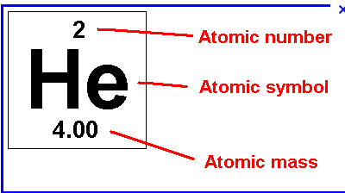
Neutrons
The # of neutrons is determined by:
  Rounded atomic mass - Atomic number
  Eg. Helium

Slide 8
Standard Notations
This is another way to write out the element and all the information about it.
It contains 3 steps:
  The _______ for the element is written out
  Then the Atomic ______ is written at the _______ left
  Then the Atomic ________ is written at the _________ left

Slide 9
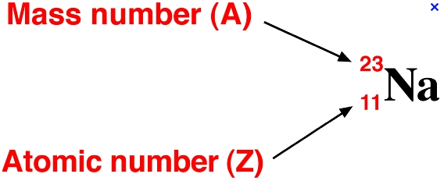
Standard Notation
This is another way to write out the element and all the information about it.
Eg. Sodium

Slide 10
Standard Notation
This is another way to write out the element and all the information about it.
You Try for Oxygen

